Slide 1

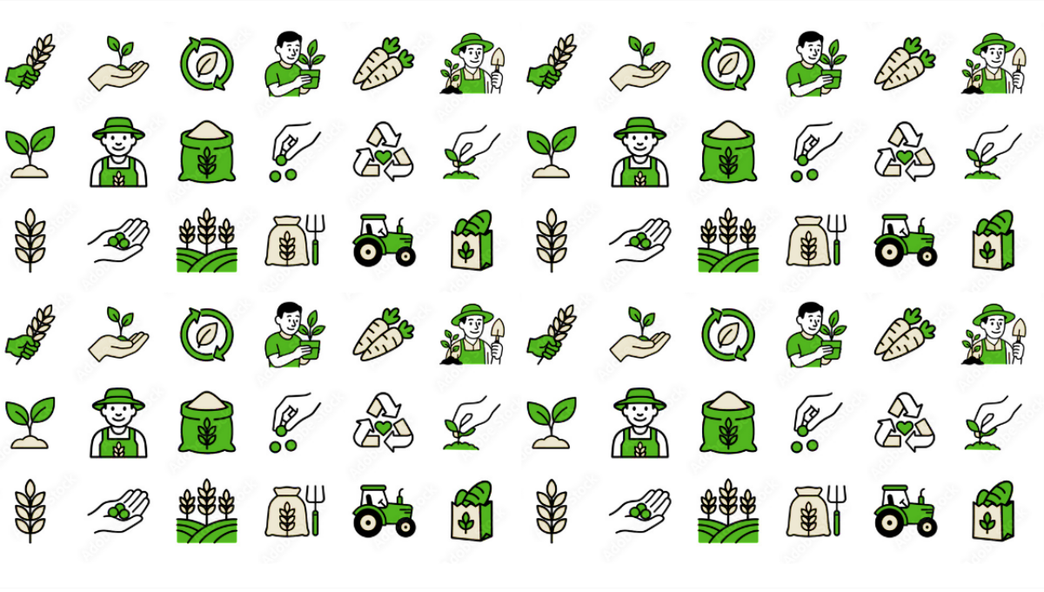


SMART INDIA HACKATHON 2025
KRISHAK SETU
Problem Statement ID – SIH25030
Problem Statement Title- AI-Based Crop
Recommendation for Farmers
Theme- Agriculture, FoodTech & Rural
Development
PS Category- Software
Team ID -
Team Name(Registered on Portal) - TACHYON

Slide 2

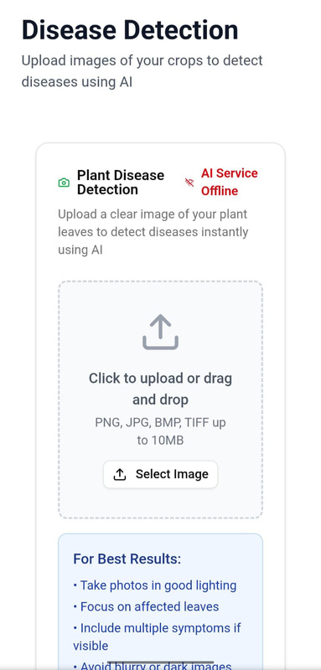
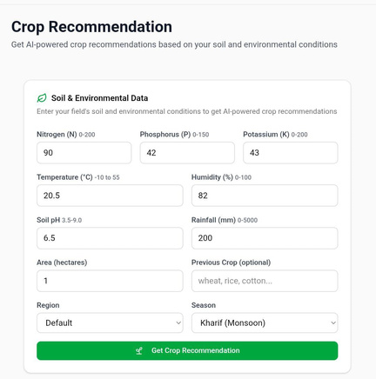
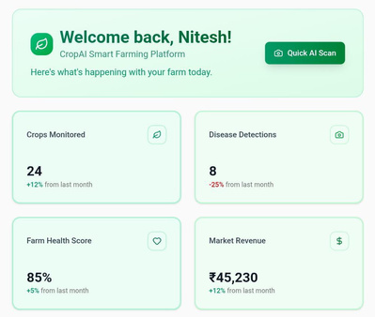

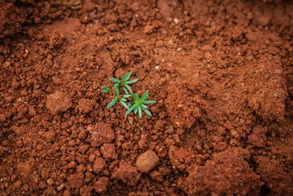
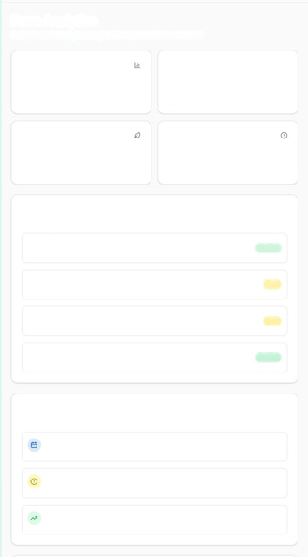
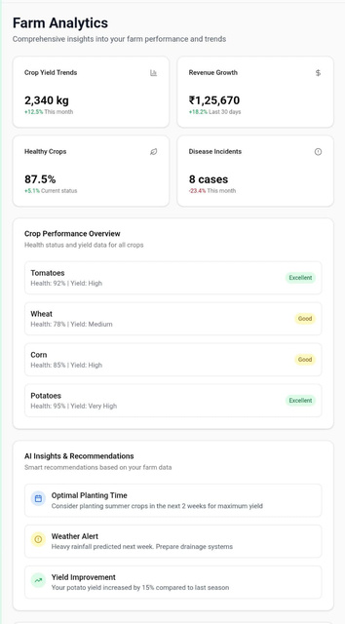



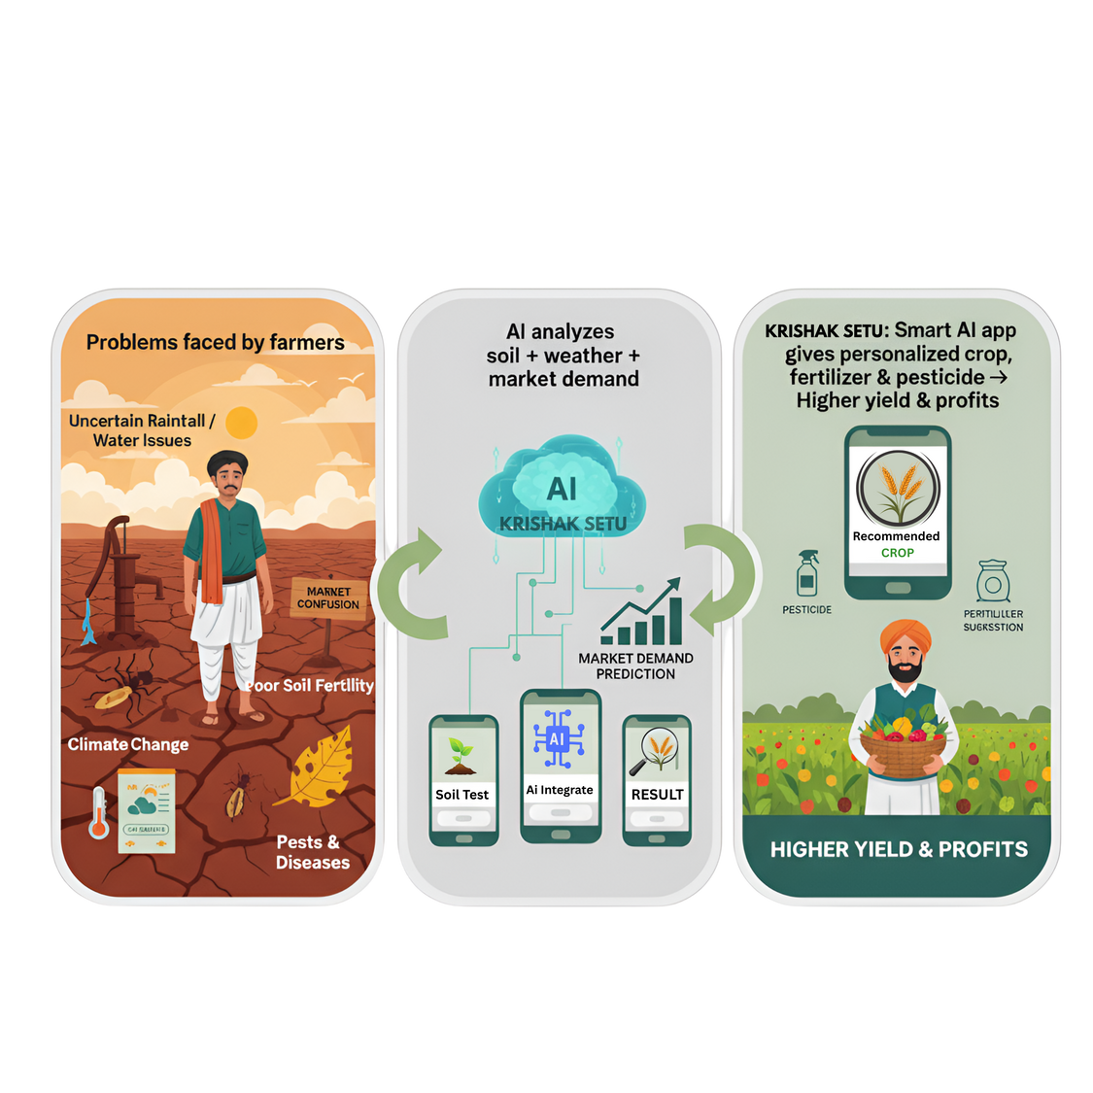

TACHYON
KRISHAK SETU
PROTOTYPE - Link
Proposed Solution
मृदा स्कैन परीक्षण
AI का उपयोग करके सर्वोत्तम फसल का पता लगाने के लिए अपनी कैप्चर की गई मिट्टी की छवि अपलोड करें
AI-based Crop Recommendation System : Recommends the best crops by analyzing soil, weather, and market data for profitability.
Fertilizer & Pesticide Guidance: Suggests precise doses of fertilizers and eco-friendly pesticides for optimal crop health.
Water Management Assistance: Provides irrigation schedules based on soil moisture and crop needs to conserve water.
Decision Support Dashboard: Displays and ranks top crop options by potential yield, cost, and profitability.
Local Language & Accessibility: A user-friendly app with local language and voice support for all farmers.
मृदा परीक्षण
मिट्टी के प्रकार का पता लगाने के लिए अपनी मिट्टी की स्पष्ट छवि कैप्चर करें
यहाँ क्लिक करें
सर्वोत्तम परिणाम के लिए :
अच्छी रोशनी में तस्वीरें लें
Innovation & Uniqueness
Soil-Test Driven Intelligence: Reads soil tests and combines with real‑time climate data for accurate crop advice.
Market-Linked Farming : Suggests crops based on current demand and price trends to boost profits.
Smart, Sustainable Inputs : Precise eco‑friendly fertilizer and pesticide guidance for cost‑effective, healthy farming.
All-in-One Platform : Personalized, end‑to‑end recommendations covering every farming need.
f
Uncertain/Rainfall
MARKET
@SIH Idea submission- Template
2

Slide 3
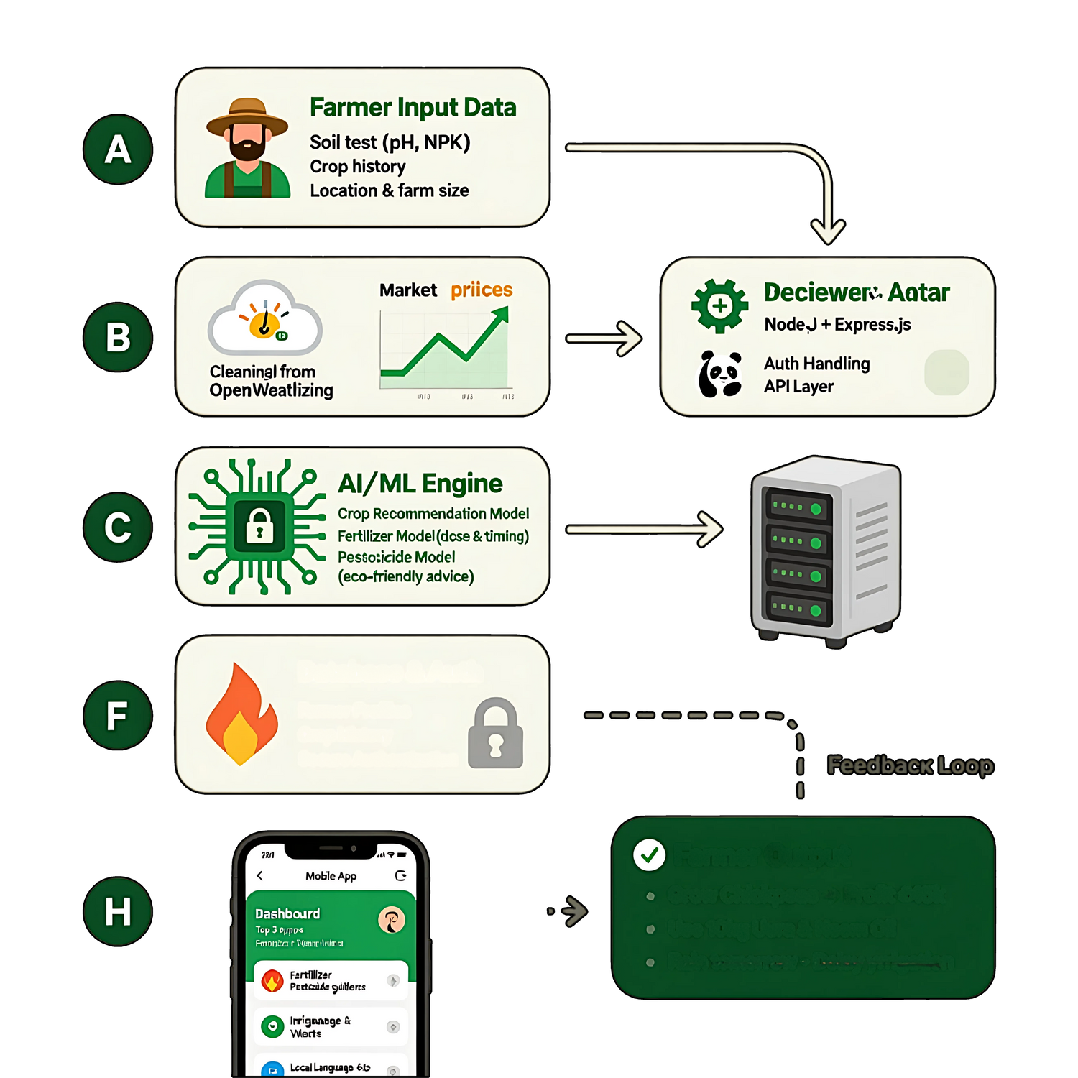






















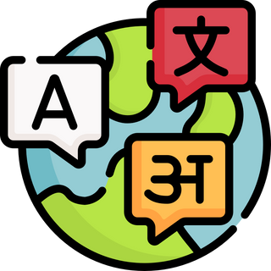
TECHNICAL APPROACH
TACHYON
Technology Stack
A
Farmer Input Data
Soil test (pH, NPK)
Crop history
Location & Farm size
Frontend : Flutter.
Backend: Node JS, Express JS.
Data: Numpy and Pandas.
Al and ML: Python with Scikit-Learn , TensorFlow or PyTorch for custom ML models.
API Services : Open Weather API.
Cloud and Deployment : Google cloud run & Vercel for the backend deployment.
B
Market Prices
Deceiver Avatar
node.js and express.js
Auth Handling
API Layer
C
AI/ML Engine
Crop Recommendation Model
Fertilizer Model (dose & Timing)
Pesticide Model
(Eco-Friendly Advice)
D
Database & Auth
Farmer Profiles
Crop History
Secure Authentication
FEEDBACK LOOP
Farmer Output
Grow Chickpeas → Profit ₹45k
Use 10kg Urea & Neem Oil
Rain tomorrow - Delay irrigation
E
Dashboard
Top 3 service
Nitesh R Kumar Sahu
Fertilizer
Pesticide Guides
Water & Irrigation
3
Language & input

Slide 4














IMPACT AND BENEFITS
TACHYON
Potential impact on the target audience:
Benefits of the Solution
IMPACT AREA | BEFORE (Traditional Farming) | AFTER (With AI Crop System)
💰 Income | Low, uncertain profit | 20–40% higher profit
🛡️ RiskHigh | crop loss due to pests & weather | 15–25% reduced crop loss
💸 Costs | Excess fertilizer & pesticide spendin | 25–35% savings
🎯 Decision Making | Based on guesswork & middlemen | Data-driven & farmer-controlled
🗣️ Accessibility | Complex methods, language barriers | Local languages + voice commands
🌱 Sustainability | Soil degradation & high water use | Healthy soil & water conservation
SOCIAL BENEFITS
It ensures sustainable development by minimizing crop damage
ENVIRONMENTAL BENEFITS
ECONOMICAL BENEFITS
Suggests appropriate fertilizer to minimize soil damage and appropriate crop to minimize crop wastage
It helps to increase living standards and per capita income of farmers, hence increases GDP of the company.
HEALTH & SAFETY BENEFIT
OPERATIONAL BENEFIT
Promotes farmer safety and healthier produce by recommending safer, precise pesticide doses.
Simplifies farm management by putting complex data into one easy-to-use dashboard.

Slide 5







TACHYON
FEASIBILITY AND VIABILITY
⚙️ FEASIBILITY
📈 VIABILITY
Challenges & Solutions
Technical: Uses existing tech: ML (Random Forest, DNN), Cloud (AWS/Azure/GCP), Mobile/Web, and IoT integration.
Data Access: Combines public datasets (soil, weather, yields) with real-time data from sensors and satellite imagery.
Modularity: Phased implementation possible: start with basic recommendations, then add advanced features (pest/disease prediction, irrigation).
Economic: Low operational cost due to open-source ML frameworks and scalable cloud infrastructure.
Multiple Revenue Streams: Subscription (premium features), API fees (suppliers/insurance), and Consulting/Data services (large farms).
Target User Base: Millions of smallholder and commercial farmers, plus agri-corporations and government bodies.
Scalable: Easy expansion from a single region/crop to multiple geographies and crop types using cloud scalability.
Long-term Value: Promotes sustainable farming and leads to increased farmer income, building a loyal user base.
Data Gaps: Challenge: Inconsistent local soil/weather data. Solution: Use Crowdsourcing for validation and satellite-based remote sensing to fill gaps.
Adoption: Challenge: Farmer trust and low digital literacy. Solution: Develop a simple, vernacular-language app and offer on-field support/demonstrations.
Integration: Challenge: Integrating with existing machinery/platforms. Solution: Develop a flexible API and focus on interoperability standards.

Slide 6

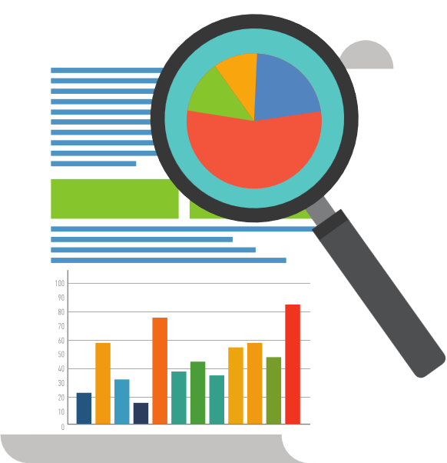










TACHYON
RESEARCH AND REFERENCES
Key References
Research Paper and Links
Artificial Intelligence in Agriculture — Rajesh Singh, Anita Gehlot, et al.
Smart Agriculture: Harnessing Machine Learning for Crop Management
AI in Agriculture for Sustainable and Economic Management — Sirisha Potluri, Suneeta Sampathy, et al.
https://www.nature.com/articles/s415
https://www.nature.com/articles/s41598-025-07003-8
https://tinyurl.com/Crop-recommendation-Ai
https://www.kaggle.com/datasets/jayaprakashpondy/soil-image-dataset
Kaggle Soil DataSet -JayaPrakashPondy
DEMO Link - https://krishak-setu.vercel.app

